Slide 1
Examining Genetic Predispositions to Alcohol Use
Ethan O’Keefe

Slide 2
Rats
My work at UNH
Behavioral Neuroscience
Identifying endophenotypes of individuals vulnerable to alcohol abuse
Propensity to consume alcohol¹
Limited in most rats (Brown Rat)
Requires significant positive associations / fading procedures.
Wistar and P-rats
Bred with a higher propensity to consume
Identify variation alcohol abuse related genes between alcohol preferring (Wistar) and non-alcohol preferring rats (Brown rat)

Slide 3
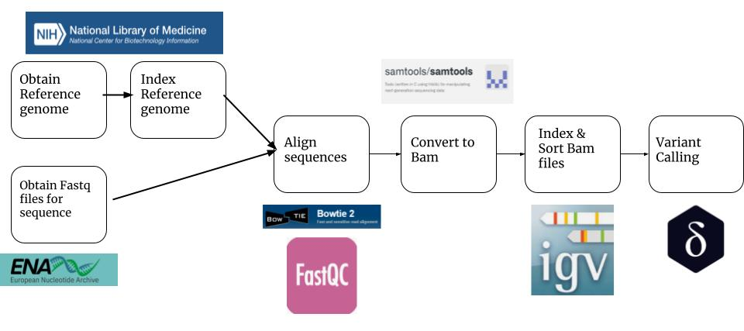
Project Overview

Slide 4
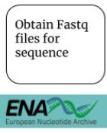
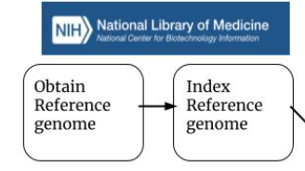
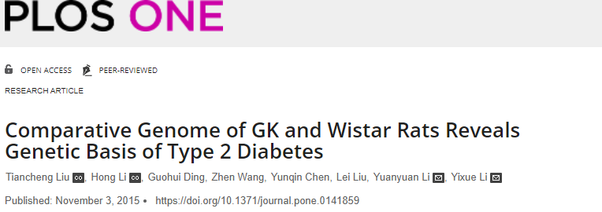
Obtaining Sequences
3
2
mRatBN7.2

Slide 5
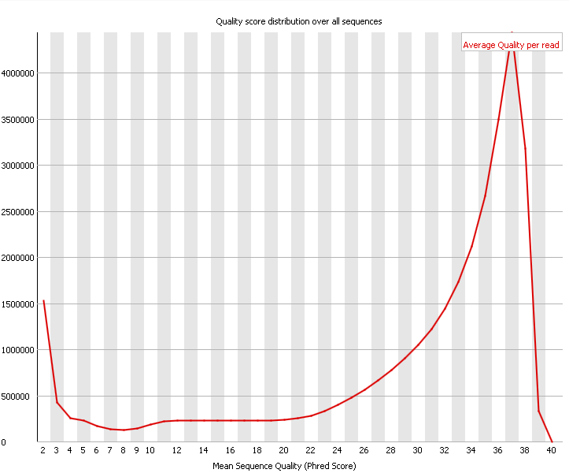

FastQC analysis
8 Concatenated fastq reads
About 64,000,000 reads (100bp) analyzed

Slide 6
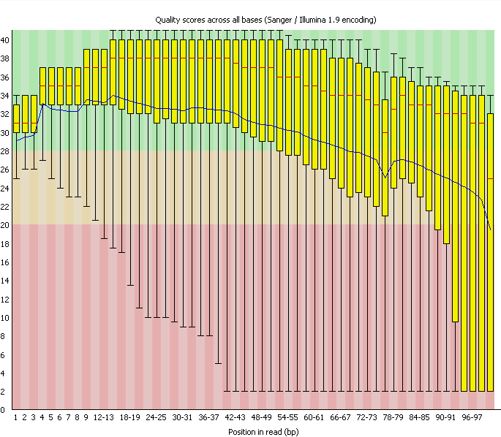
FastQC analysis continued

Slide 7


Sequence alignment
Average alignment rates
Overall coverage - 93.71%
5.22% were not aligned
72.21% aligned once
21.50% aligned more than once
Bowtie 2
Command line sequence alignment tool
Used for its speed and sensitivity
Aligns forward and reverse reads to an indexed reference genome

Slide 8
Converting .Sam to .Bam
Sam - sequence alignment map
Bam - binary alignment map
Compresses to about 1/4th the size

Slide 9
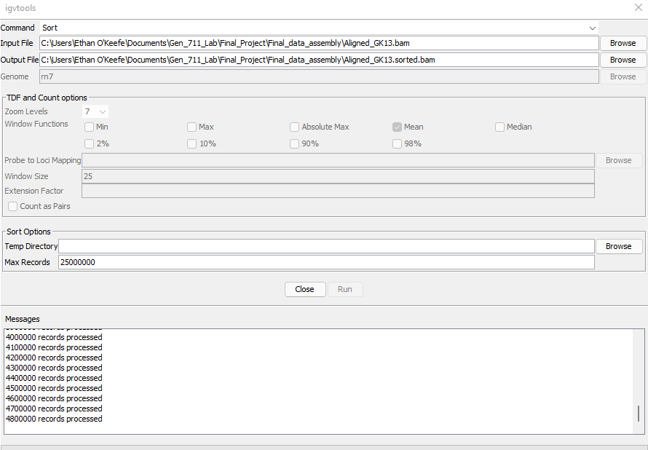
Indexing and Sorting .bam files
IGV tools
Built into browser
Command line conda program
Sorting Indexing
.bam -> .sorted.bam -> .sorted.bam.bai

Slide 10
Visualizing in IGV

Slide 11
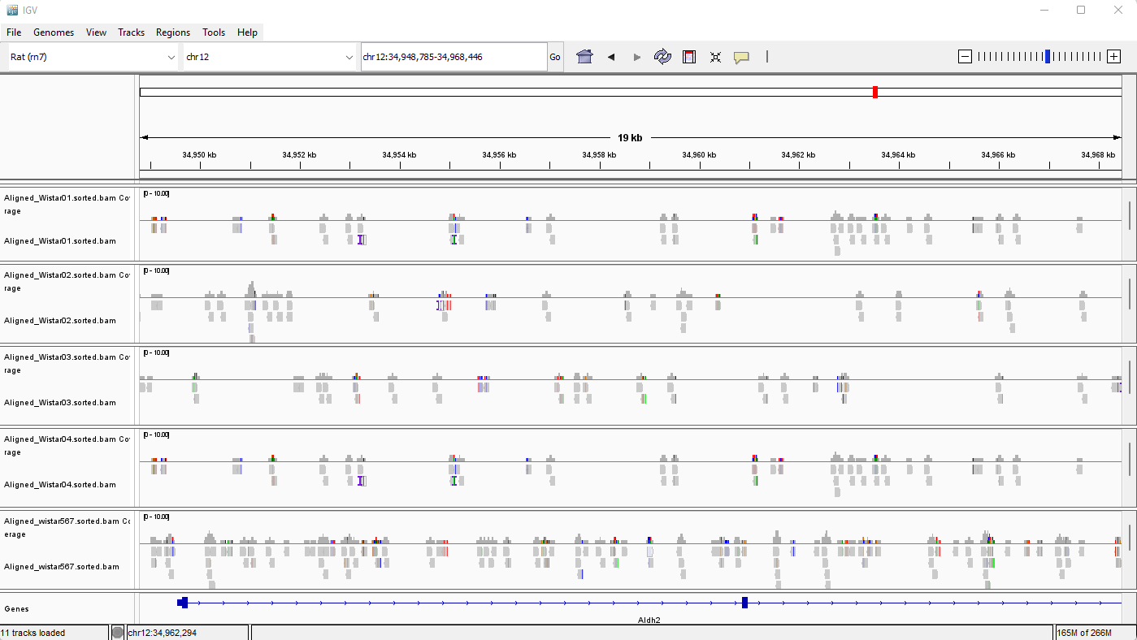

Slide 12

Variant Calling and Intended Analysis
Search for SV and CNV in alcohol abuse linked genes
Delly - detecting structural variants (SV)
GATK - detecting SNP and CNV
Genes of interest (AUD)^{4,5}
Aldh2
ADH1B,C
FTO
SLC39A8
VRK2
DCLK2
ISL1
BRAP

Slide 13
Citations
Vengeliene, Valentina. “A Comparative Study on Alcohol-Preferring Rat Lines: Effects of Deprivation and Stress Phases on Voluntary Alcohol Intake.” Alcoholism, Clinical and Experimental Research, U.S. National Library of Medicine, https://pubmed.ncbi.nlm.nih.gov/12878910/.
Liu, Tiancheng, et al. “Comparative Genome of GK and Wistar Rats Reveals Genetic Basis of Type 2 Diabetes.” PloS One, Public Library of Science, 3 Nov. 2015, https://www.ncbi.nlm.nih.gov/pmc/articles/PMC4631338/.
“MRATBN7.2 - Genome - Assembly - NCBI.” National Center for Biotechnology Information, U.S. National Library of Medicine, https://www.ncbi.nlm.nih.gov/assembly/GCF_015227675.2.
Edenberg, Howard J, and Tatiana Foroud. “Genetics and Alcoholism.” Nature Reviews. Gastroenterology & Hepatology, U.S. National Library of Medicine, Aug. 2013, https://www.ncbi.nlm.nih.gov/pmc/articles/PMC4056340/.
“Study Reveals Genes Associated with Heavy Drinking and Alcoholism.” ScienceDaily, ScienceDaily, 2 Apr. 2019, https://www.sciencedaily.com/releases/2019/04/190402124314.htm.

